Slide 1
Aakash Nihalani
/// New York- based artist
/// Physical Graffiti /// Jaskirat, Hanyang and Vicky

Slide 2
Aakash Nihalani
/// About the artist
Base Country: US
Type of work: Tape, woord, code, canvas …
Aakash creates geometric shapes with brightly colored tape, from simple illusions of cubes to very complex patterns. Some of the pieces incorporate people or an aspect of the wall into the illusion.
Geometric shapes: he is captivated by the urban architecture of the city: big boxes, filled with smaller boxes, an endless network of cubes.
Color palette: colors and tones from everywhere. Using bright colors allows his work to stand out from the architecture itself (kind of a highlighter)
Notes:
/// Playful masking tape illusions
Other tools: acrylic, flashe, mixed media, canvas, corrugated plastic, wood, magnets. Using coding and motion software, a sensor picks up the viewer's hand movement on the projected design and, in real time, changes the overall look of the piece.

Slide 3
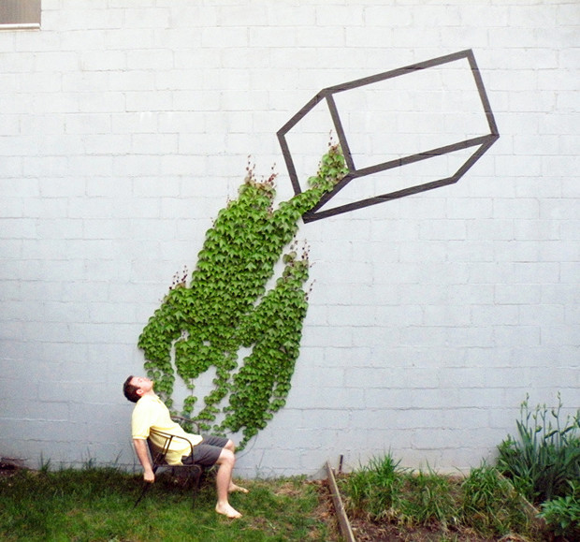
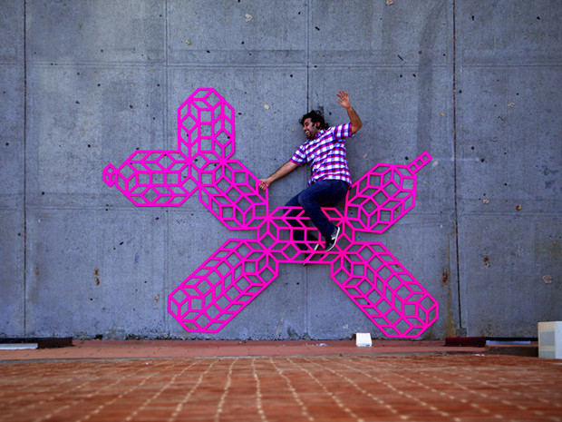
Where The Red Fern Flows
Overlap
Notes:
Large wall sculptures constructed from wood in a bold, bright palette. Paintings that shift foreground and background the longer you look at them.

Slide 4
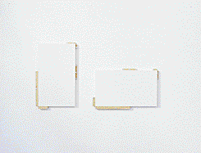
New Paintings
Notes:
Large wall sculptures constructed from wood in a bold, bright palette. Paintings that shift foreground and background the longer you look at them.

Slide 5
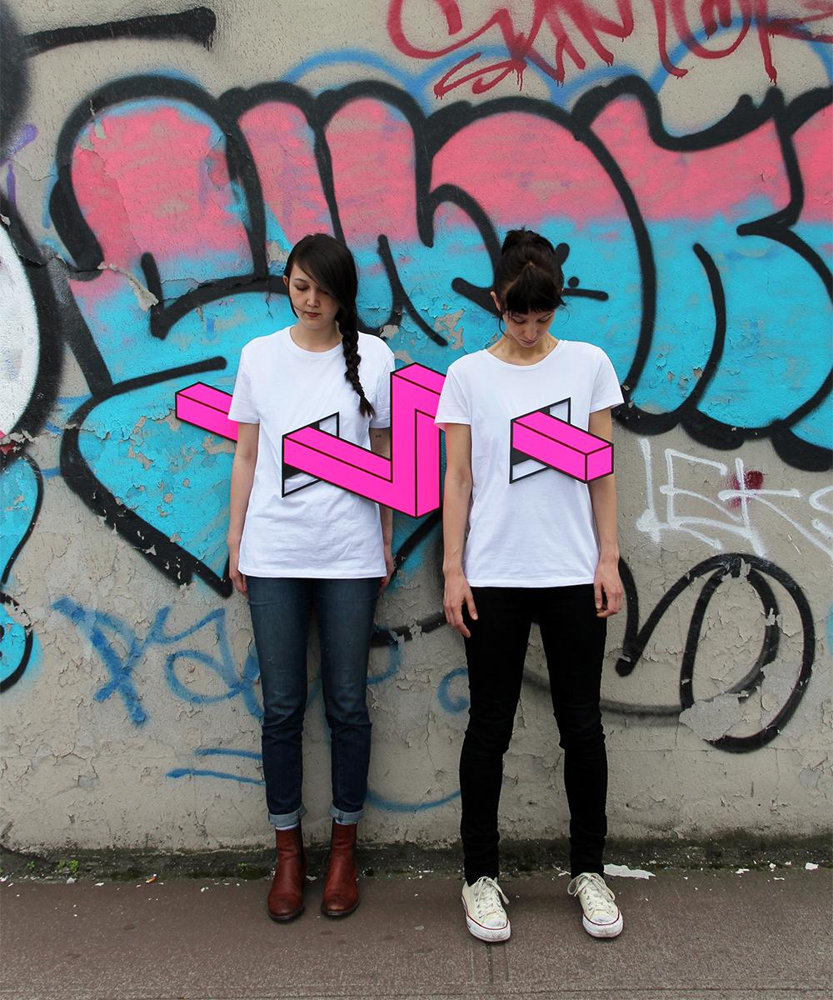
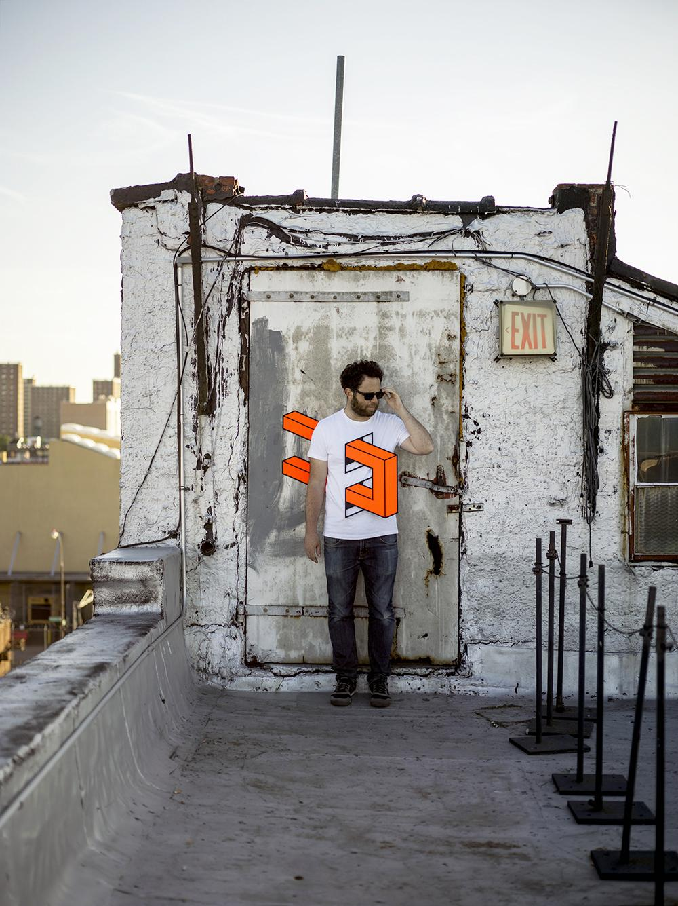
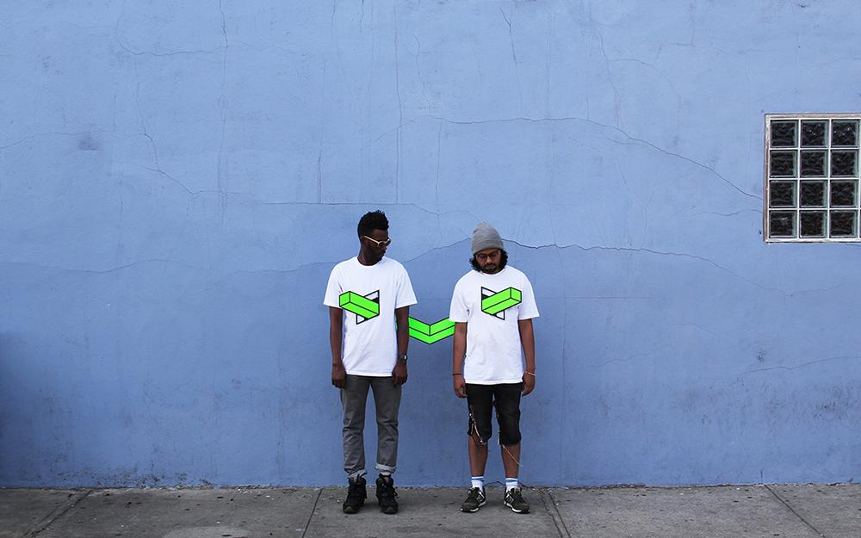
Landlines
Notes:
Large wall sculptures constructed from wood in a bold, bright palette. Paintings that shift foreground and background the longer you look at them.

Slide 6
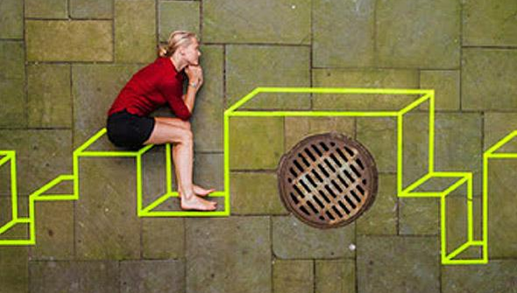
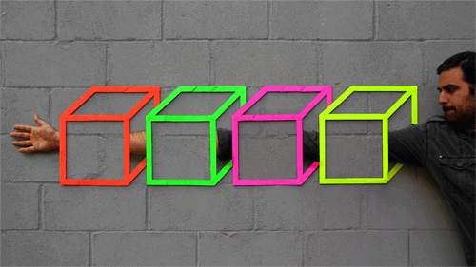
Courtyard
Armslength
Notes:
Large wall sculptures constructed from wood in a bold, bright palette. Paintings that shift foreground and background the longer you look at them.

Slide 7
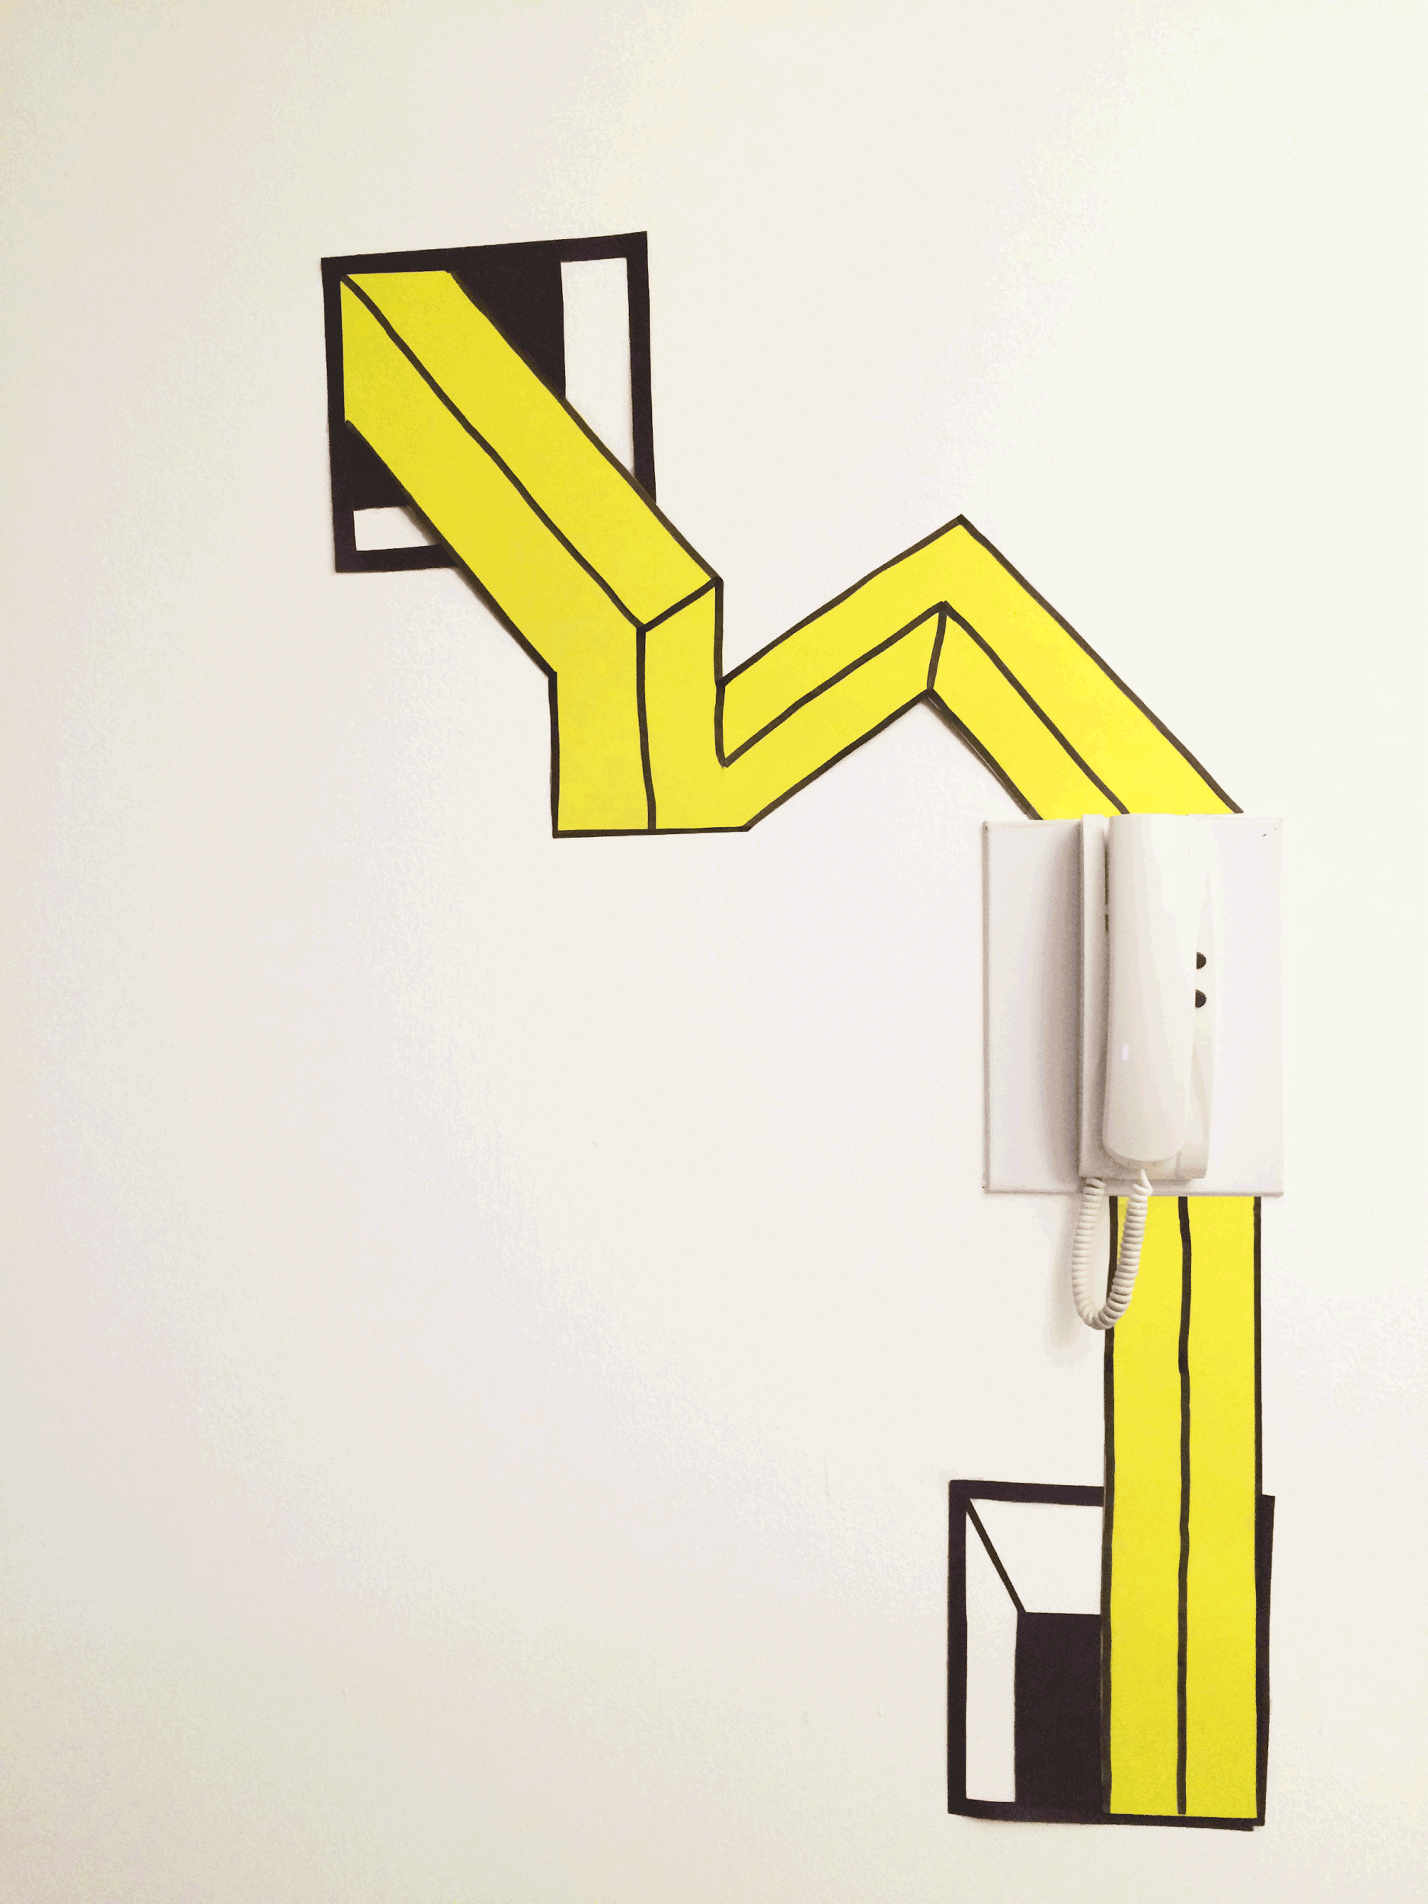
/// Prototype I

Slide 8
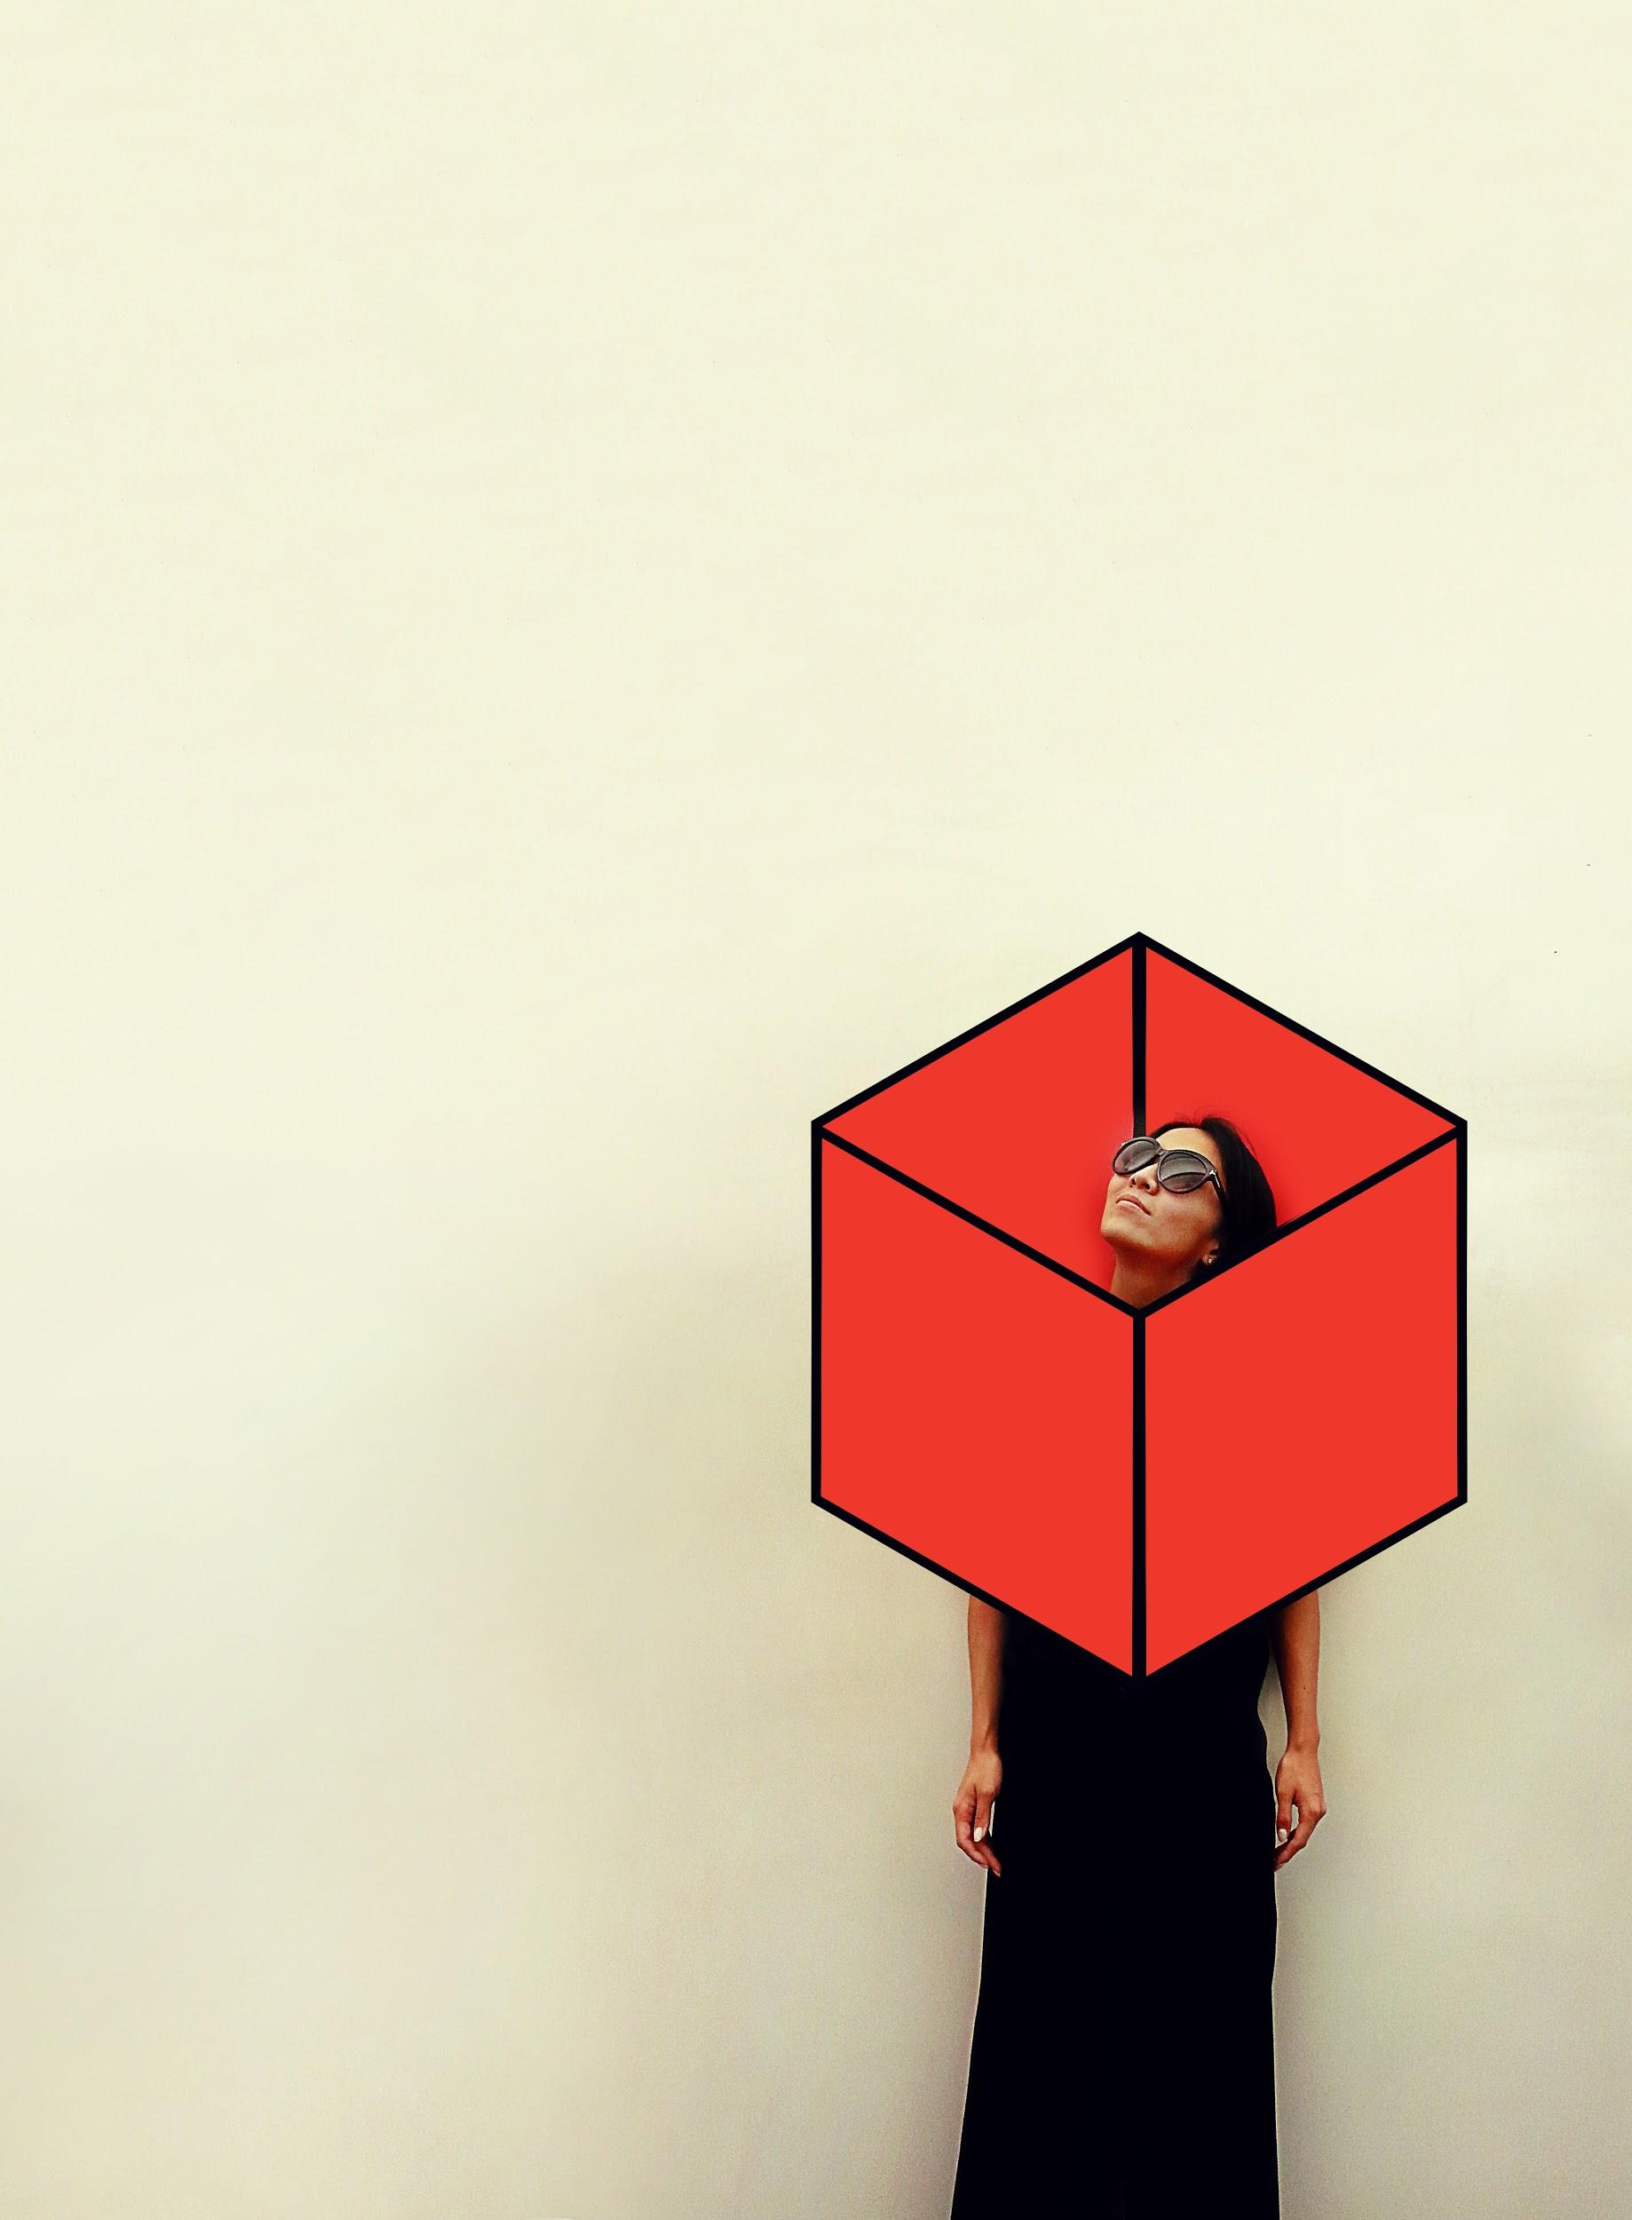
/// Prototype II

Slide 9
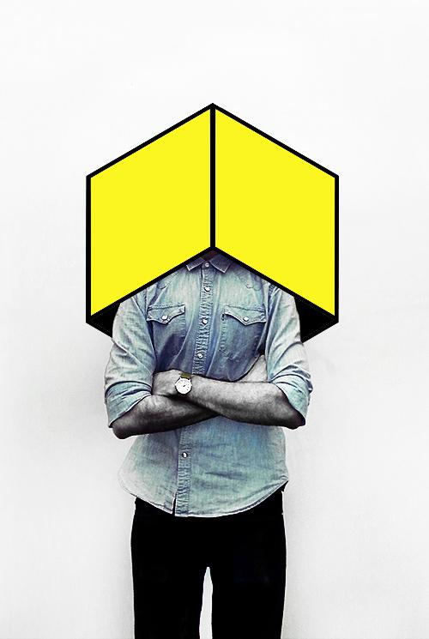

Slide 10
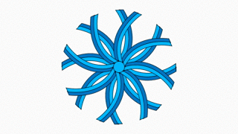
/// Prototype III

Slide 11
Aakash Nihalani
/// New York- based artist
View more work: www.eyescreamsunday.com

