Slide 1
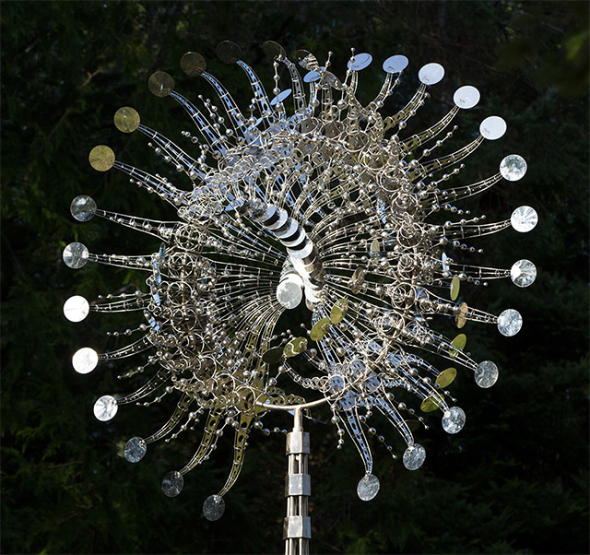
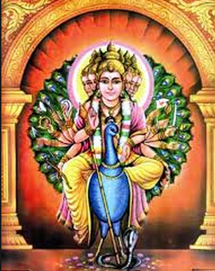
IDEA THEME 1
Metaphors we can look into can be religious intangibility of
Technology in movement?
Similar to your technsi
project, I think the fact we believe in a data, cloud, tech entity, it’s almost like the symbolism of religious sculptures back in the day..
Murugan, the commander of all gods,

Slide 2
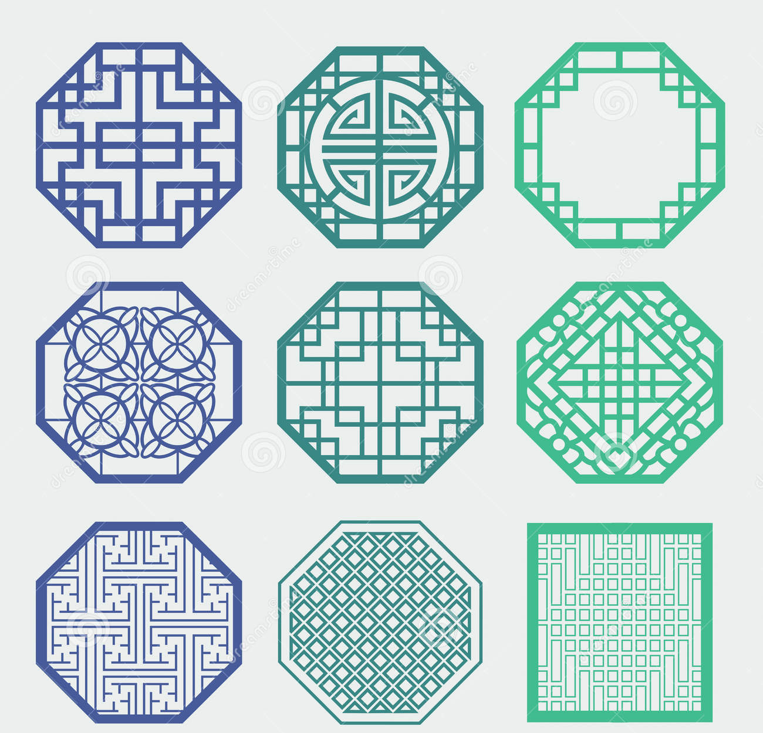
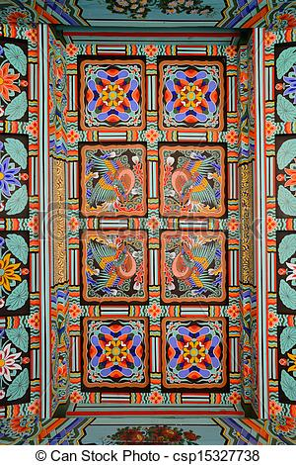
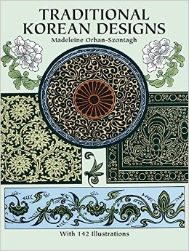
IDEA THEME 2
Along the lines of movement and geometry:
Korean traditinoal patterns are very geomteric and mostly ciruluar in design. They have distinct colors of green, red, blue, and yellow always
They were always used for buildings and gateways to a kingdom or reglious place.

Slide 3
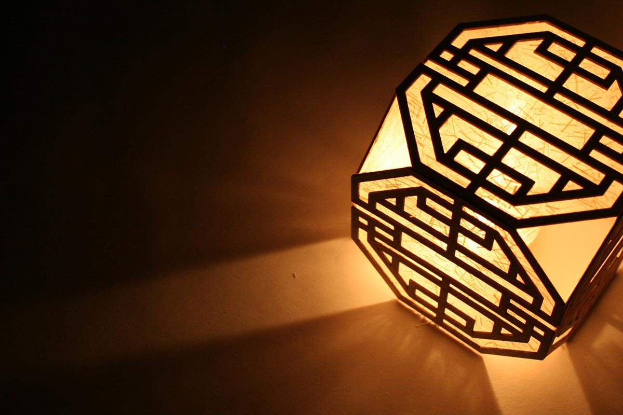
http://45symbols.com/publication/?page_id=1414

Slide 4
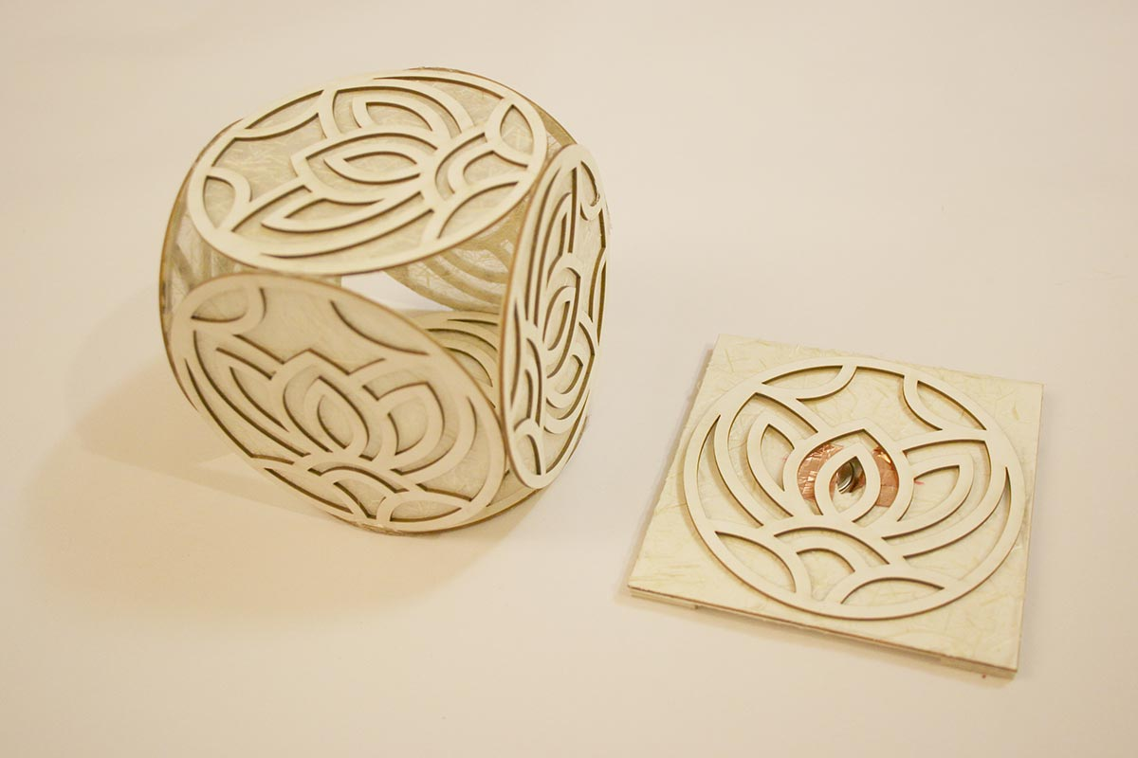

Slide 5
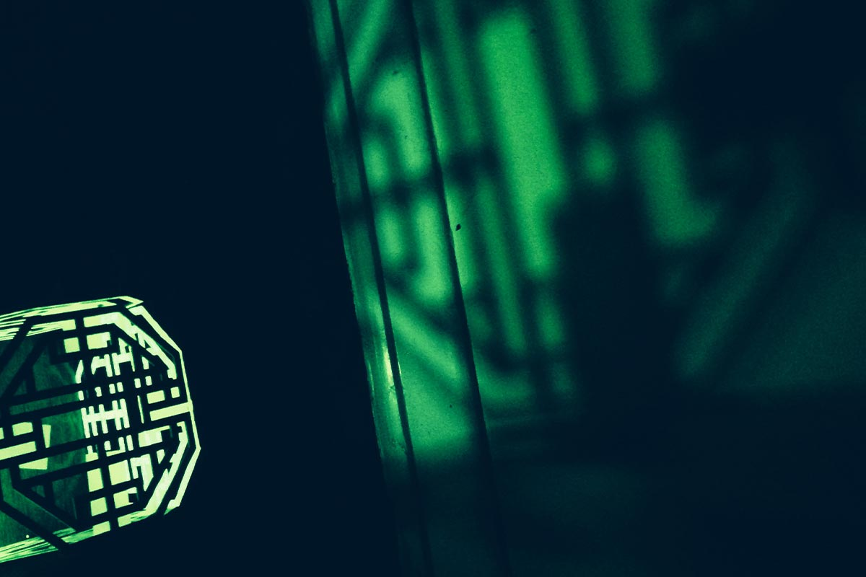

Slide 6
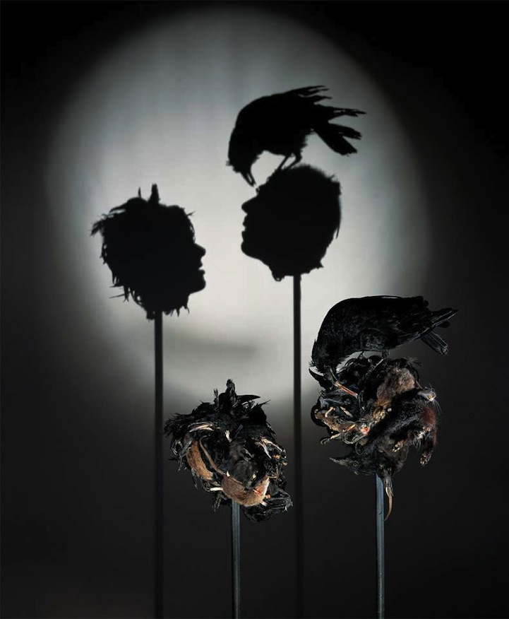
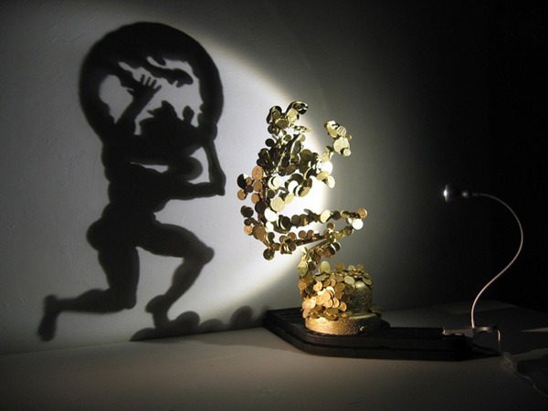
IDEA THEME 3

Slide 7
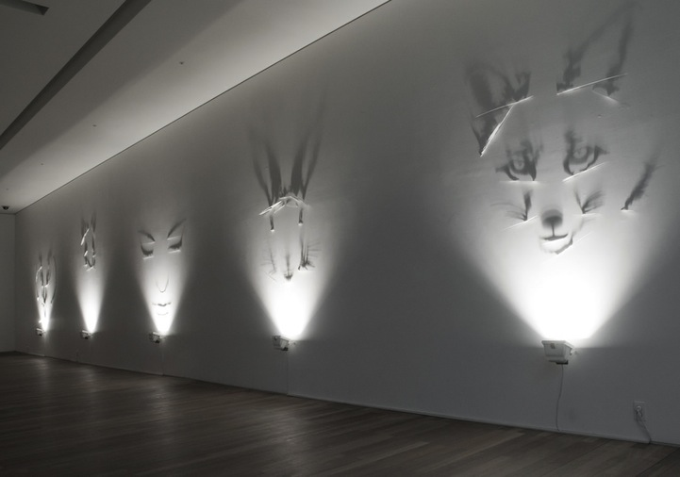

Slide 8
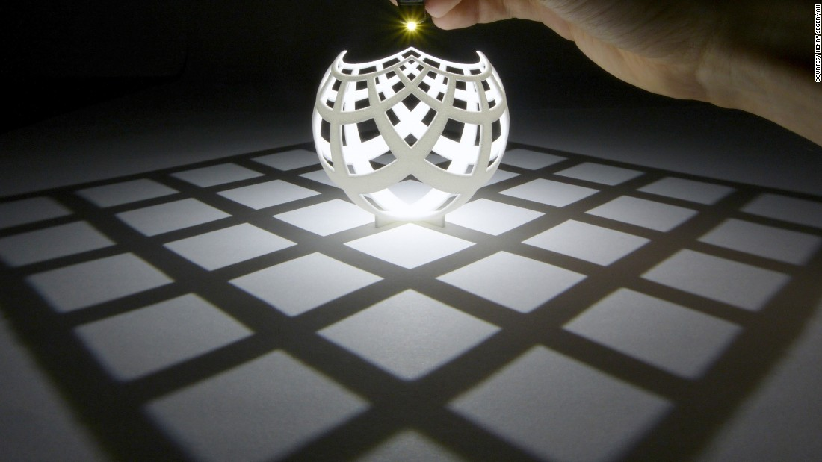
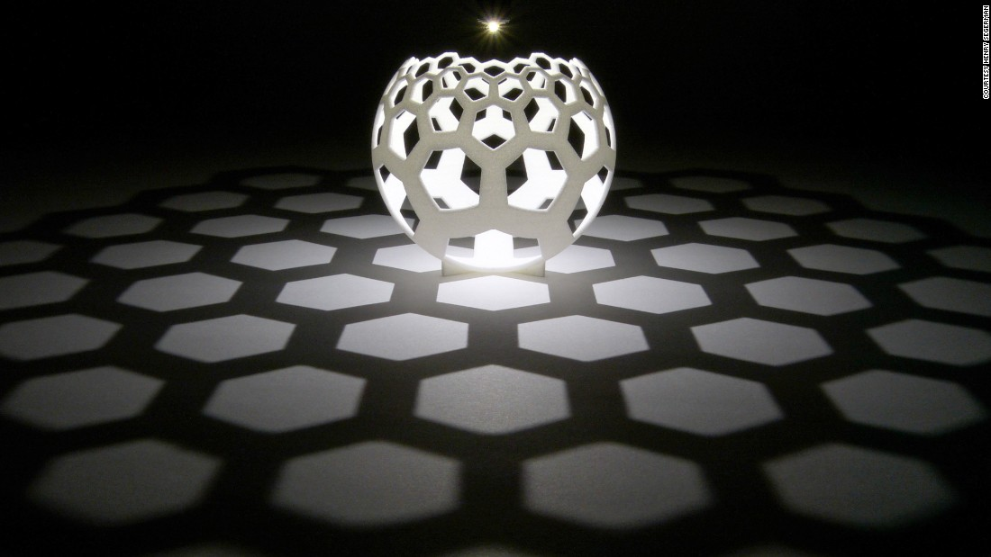

Slide 9
Other inspiration

Slide 10
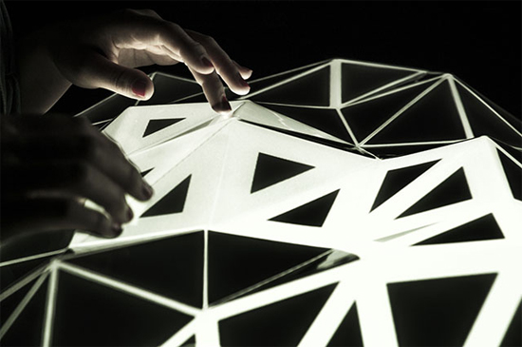
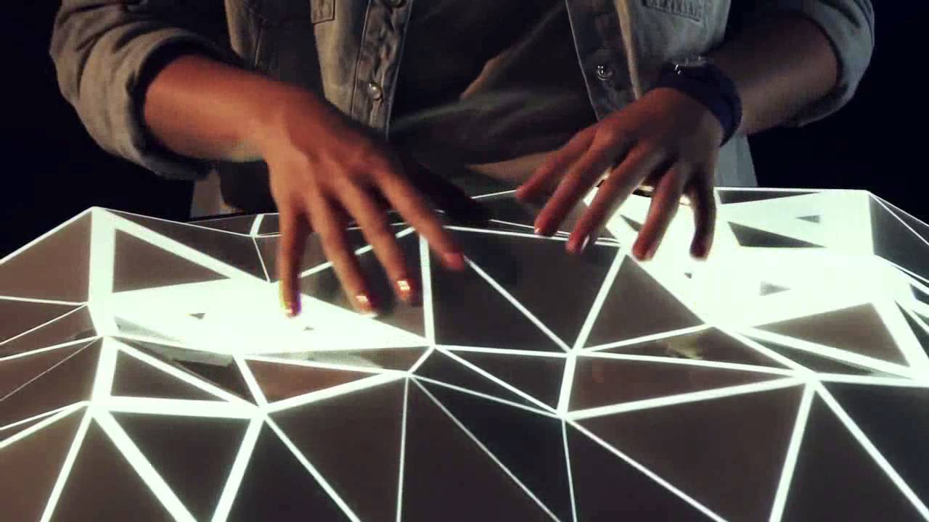

Slide 11
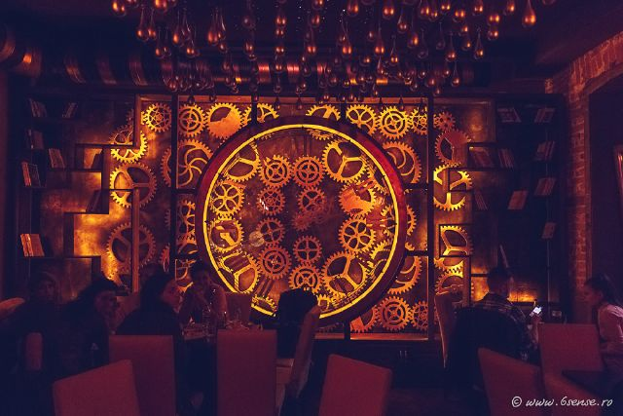

Slide 12
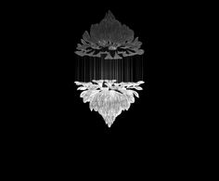
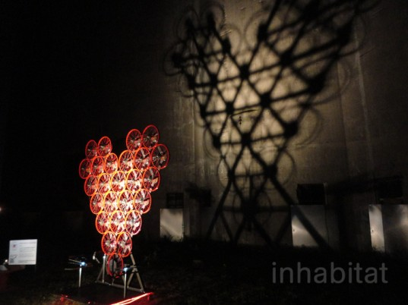

Slide 13
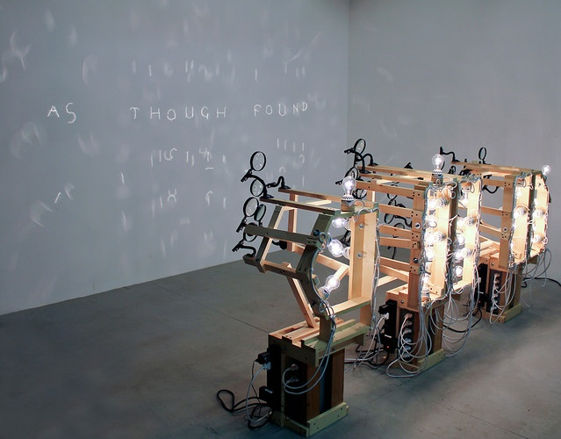

Slide 14
